Slide 1
Azure Training Day Migrating .NET applications to Azure

Slide 2

Presentation title
Let’s get Started!
Tell us what you think by completing our survey
Schedule a post-event session to address your specific requirements.
Speaker name
Title
Learn more : aka.ms/techdocs
Get certified : aka.ms/microsoftlearn
Sign up Developer newsletter: aka.ms/usdevconnect

Slide 3
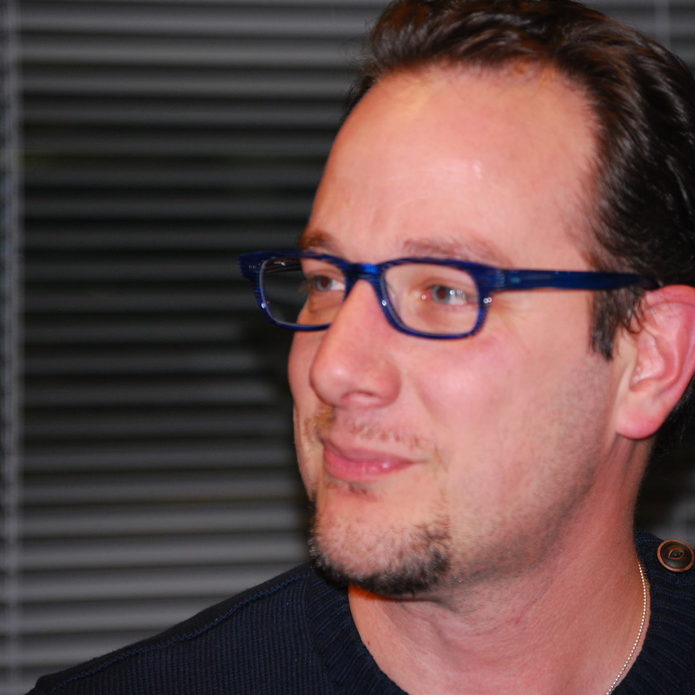

About Me…
Peter De Tender – MCT, Azure MVP
CEO and Lead Technical Trainer of 007FFFLearning.com, +20 years IT experience, mainly datacenters and Microsoft Infrastructure background
Full-time in Azure since 2013 (Readiness & Architect)
Azure Advisor, Azure Certified Architect
Technical Writer, Book author, Courseware Creator
Living in Belgium, but traveling worldwide 90% of my time, helping larger Microsoft Partners, customers and Microsoft FTEs in learning about and using Azure, by providing workshops with passion
peter@pdtit.be
@pdtit @007FFFLearning
http://www.facebook.com/pdtit
http://www.linkedin.com/in/pdtit

Slide 4
Workshop delivery
For the technical trainers:
Each Module could be presented as a stand-alone module, although the full potential comes from delivering all modules
HOL are somehow depending on each other, starting from the IAC-lab, where students deploy the VM-based source environment, moving to WebApps, SQL PaaS, Docker, Azure Container Registry, running Azure Container Instance, and ultimately Azure Container Services with Kubernetes. (only labs that could be skipped are WebApps and AKS)
The HOL solution is based on a ASP.NET Core app « SimplCommerce » (Open Source), using SQL Database

Slide 5
Workshop delivery
For the technical trainers:
Whenever you detect any mistakes, issues, wrong wordings,… in presentations or LAB guides, please send an email to :
msdevseriessupport@007FFFLearning.com, subject « Azure Developer Series – Containers », so we can take care of this and fixing it immediately
Latest version of all content should be available on GitHub:
http://www.github.com/007FFFLearning/MSDevSeriesSupport

Slide 6
Application Migration
Managing and Monitoring Azure Kubernetes Services
Peter De Tender
@pdtit @007FFFlearning

Slide 7
Key Objectives
What you will learn in this section
Enabling Container Scalability in AKS
Monitoring Azure Kubernetes Services
Using Kubernetes dashboard with Azure Kubernetes Services

Slide 8

Note regarding Demos
The demo slides are mainly used as a placeholder for in-person delivery of this workshop.
If you are watching this as a recorded session, know the demos are snippets from the full lab exercise related to this workshop module, and not fully-orchestrated demo scenarios.

Slide 9
Enabling Container Scalability

Slide 10
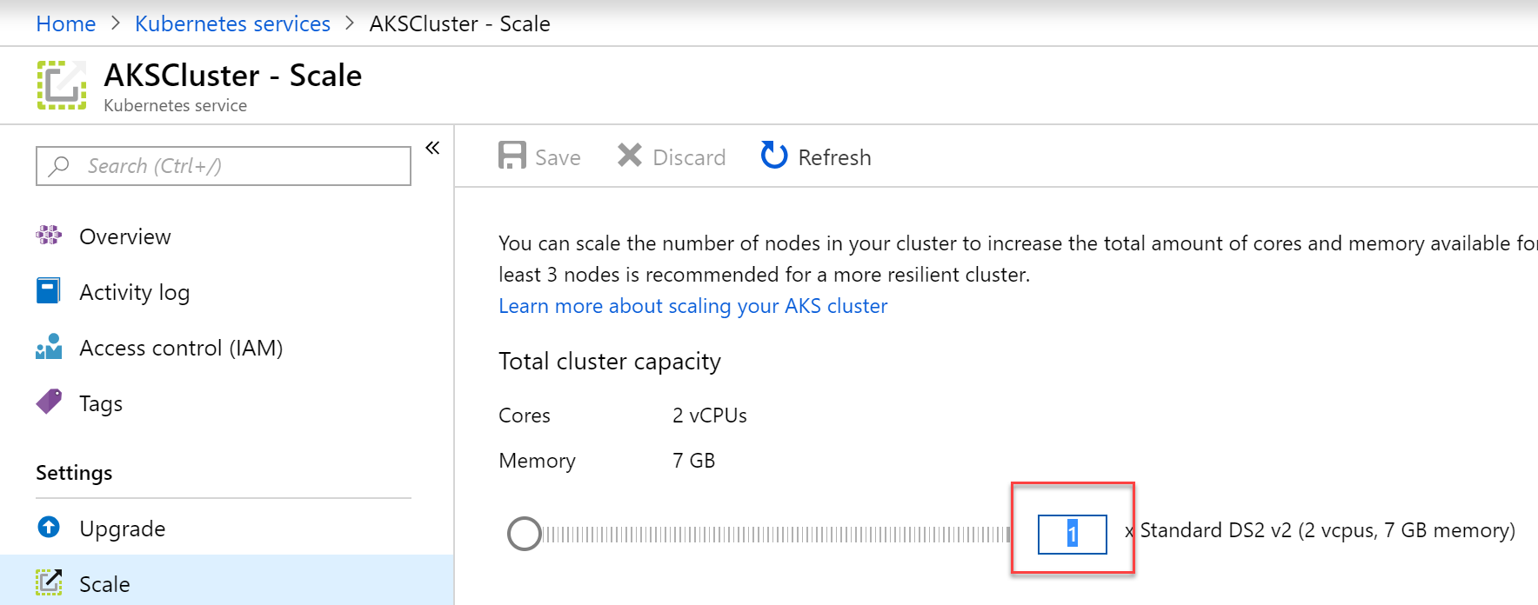
AKS Scale
Option 1: Scaling the Nodes
Az aks scale –-resource-group AKSRG –-name AKSCluster –-node-count 3

Slide 11
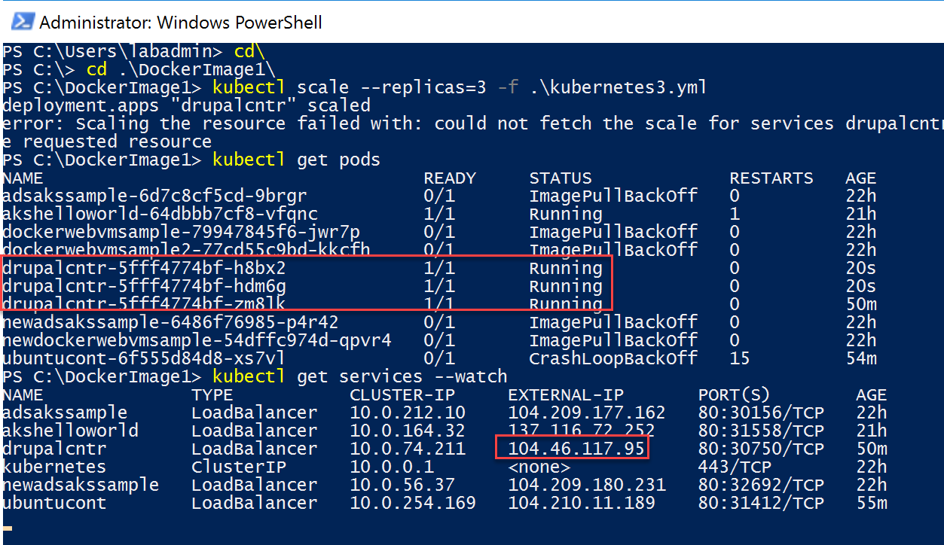
AKS Scale
Option 2: Scaling the PODS
kubectl scale --replicas=3 -f .\kubernetes3.yml
Scaling PODS means you technically deploy multiple instances of your app container

Slide 12
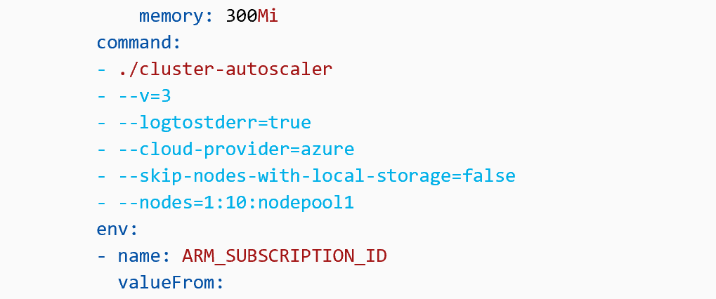
AKS Container AutoScaler
Preview
kubectl create -f aks-cluster-autoscaler.yaml
kubectl autoscale deployment azure-vote-front --cpu-percent=50 --min=3 --max=10
AutoScaling checks pending PODS, based on values in the Yaml-file.
Define a min and max value
e.g. Run 3 nodes minimum, with a maximum of 10, when CPU +50%.

Slide 13
Demo
Scaling Azure Kubernetes Services

Slide 14
Monitoring AKS in Azure

Slide 15
AKS Monitoring
You can’t manage what you don’t see…
Identify AKS containers that are running on the node and their average processor and memory utilization.
Identify where the container resides in a controller or a pod.
Review the resource utilization of workloads running on the host that are unrelated to the standard processes that support the pod.
Understand the behavior of the cluster under average and heaviest loads.

Slide 16
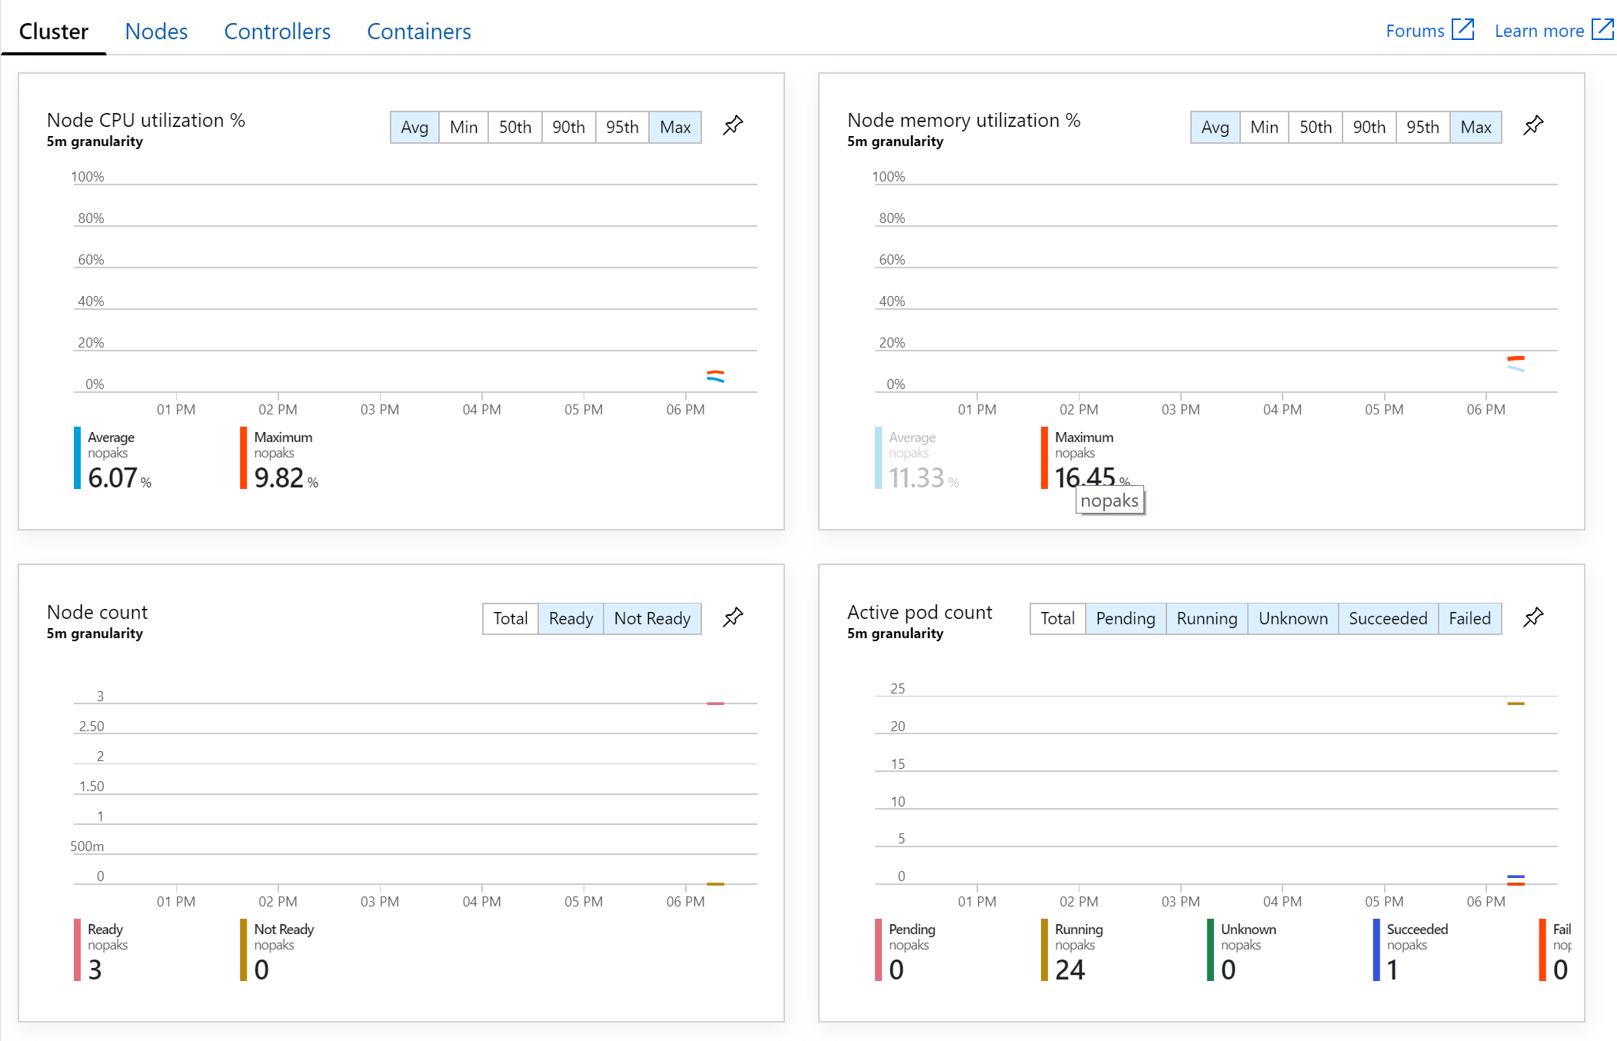
AKS Monitoring
Built-in monitoring capabilities of the AKS Cluster, provided by Azure Monitor
Cluster
Nodes
Controllers
Containers

Slide 17
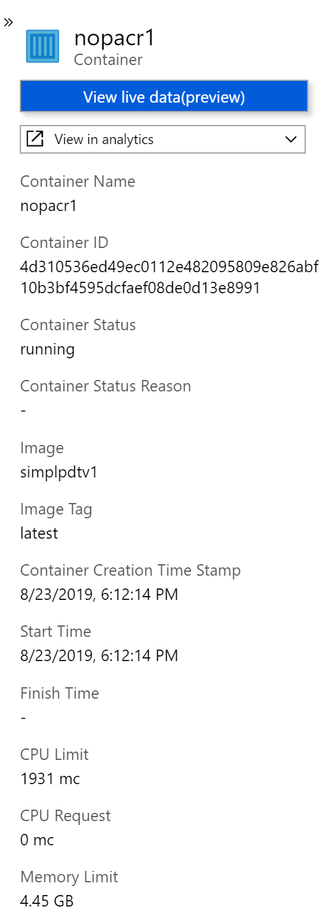
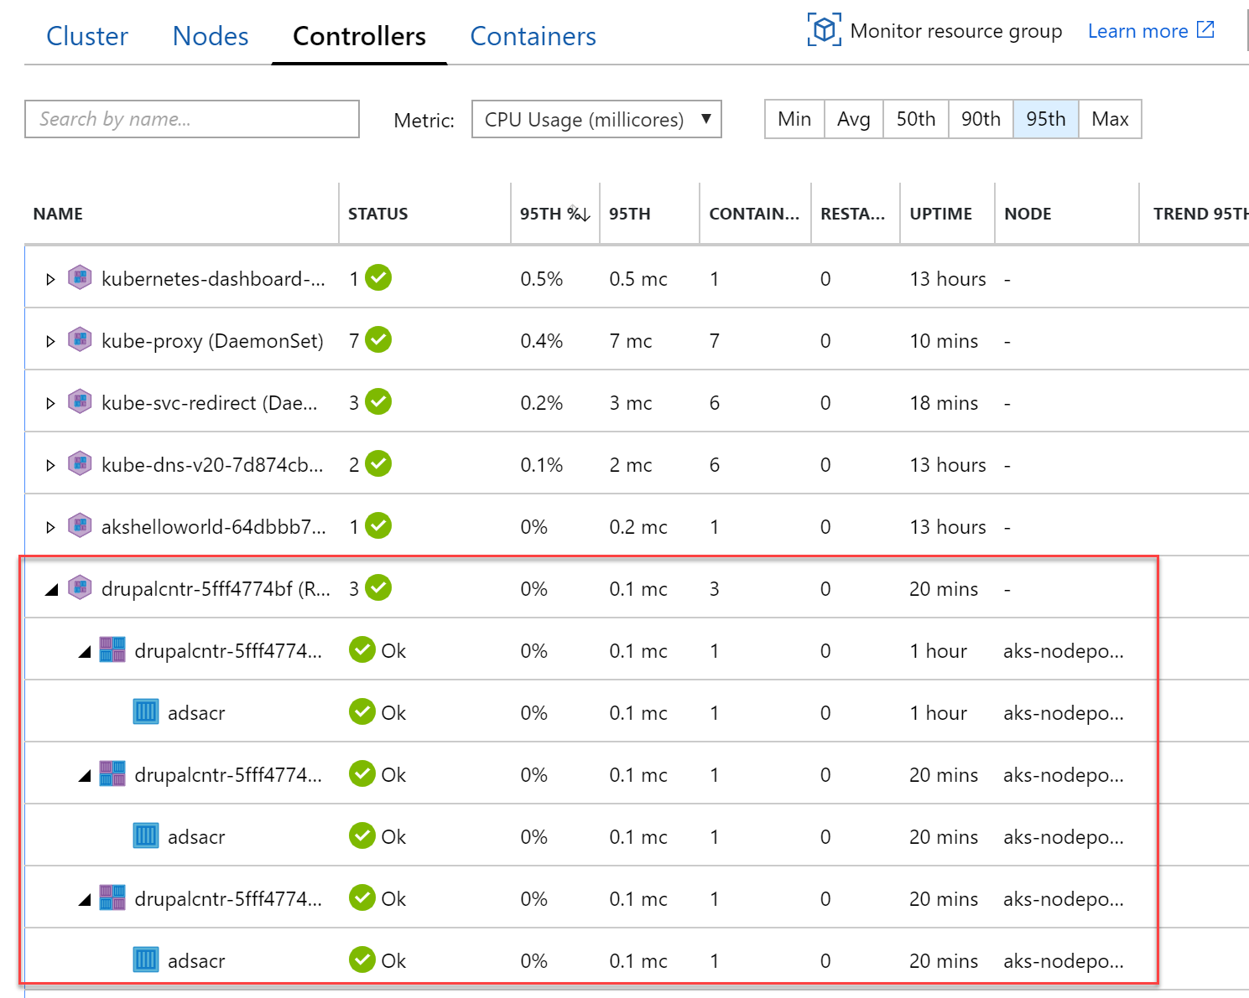
AKS Monitoring
Built-in monitoring capabilities of the AKS Cluster, provided by Azure Monitor
Cluster
Nodes
Controllers
Containers

Slide 18
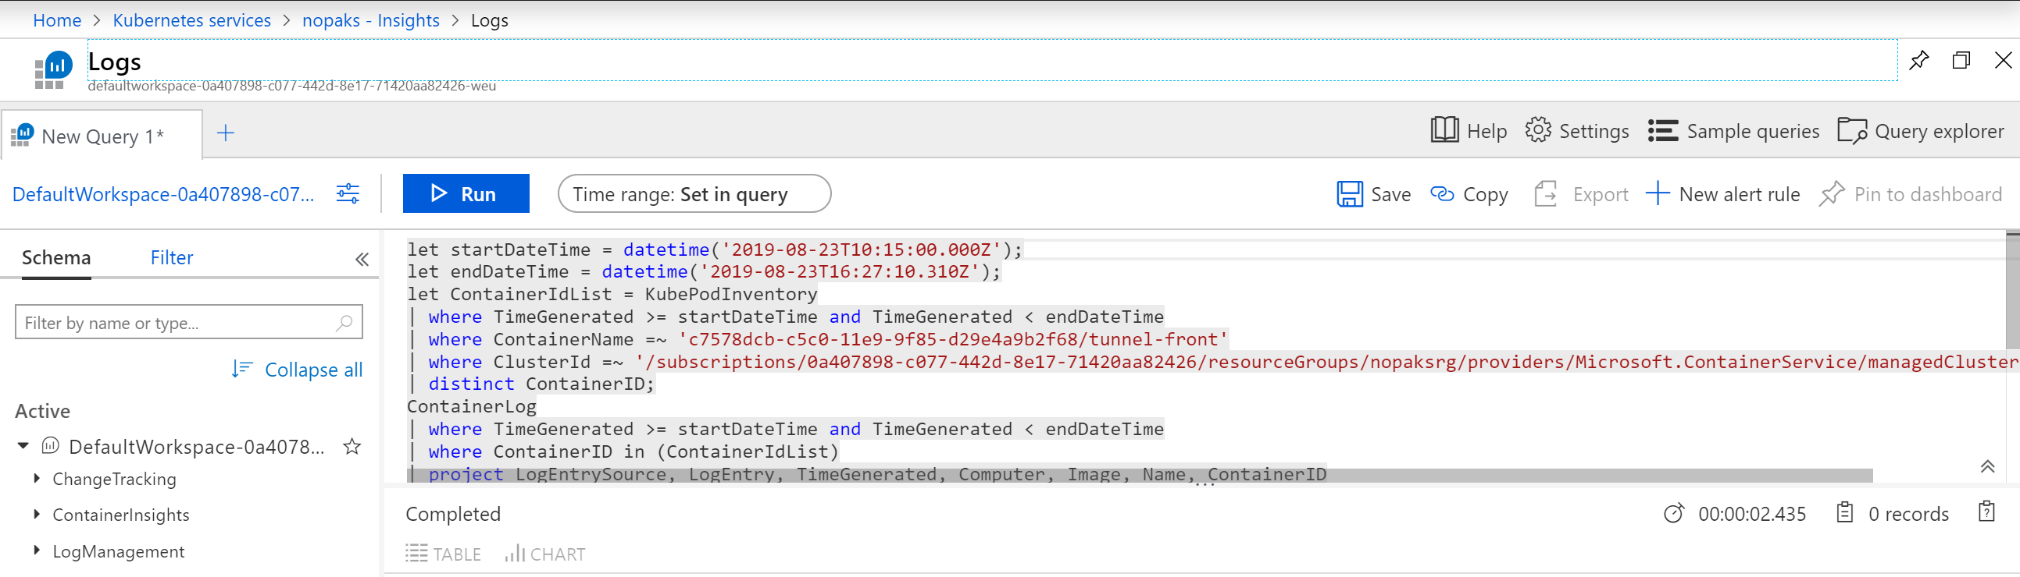
AKS Monitoring – Log Analytics
Run Powerful Queries against the AKS Cluster, provided by Log Analytics
Cluster
Nodes
Controllers
Containers

Slide 19
Demo
Monitoring AKS in Azure

Slide 20
Using the Kubernetes Dashboard

Slide 21
Kubernetes Dashboard
You can’t manage what you don’t see…
Kubernetes includes a web dashboard that can be used for basic management operations. This dashboard lets you view basic health status and metrics for your applications, create and deploy services, and edit existing applications.
az aks browse --resource-group AKSResourceGroup --name AKSCluster

Slide 22
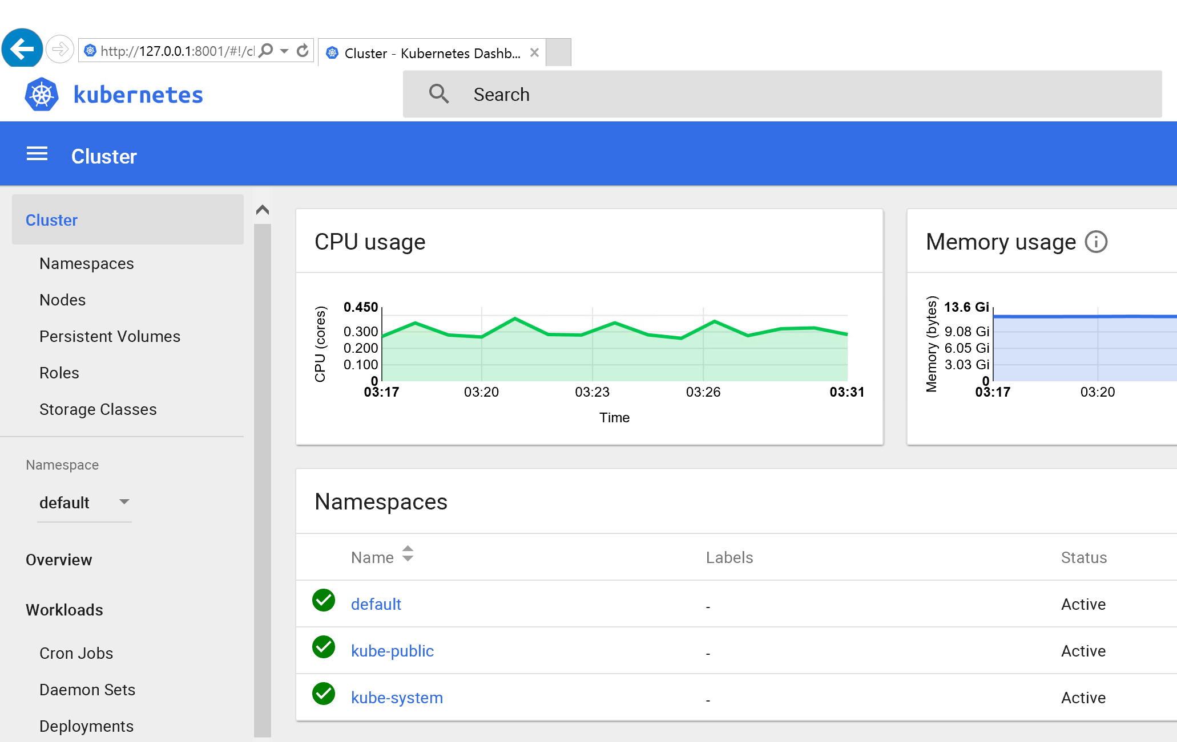
Using the Default Kubernetes Dashboard
You don’t have to use the Azure Monitor-based version…
Install latest version of the kubectl CLI tool
Connect to the AKS Cluster with the correct credentials
az aks browse…
Could be beneficial in a multi-environment Kubernetes setup, as the
dashboard is native to Kubernetes, no matter where the cluster runs

Slide 23
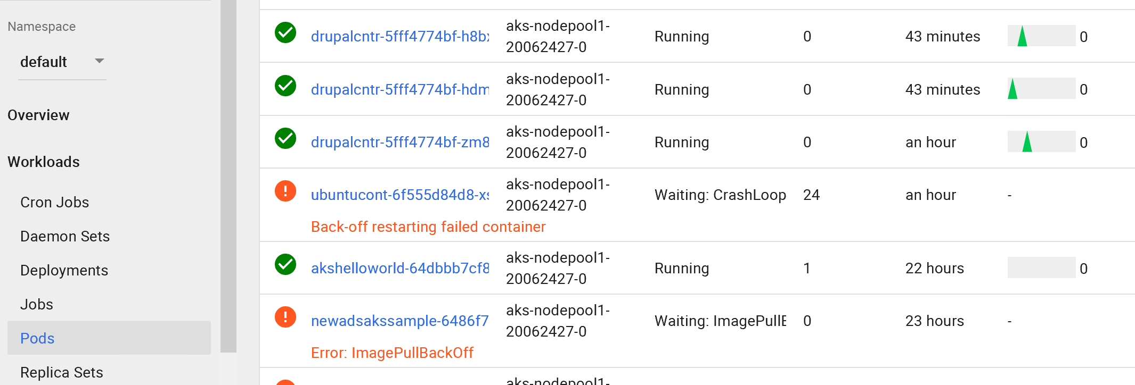
Using the Default Kubernetes Dashboard
You don’t have to use the Azure Monitor-based version…
Shows detailed information on:
- Jobs - Pods - Nodes - …
If AKS cluster is using RBAC, your dashboard will fail because of missing rolebinding:
FIX
kubectl create clusterrolebinding kubernetes-dashboard --clusterrole=cluster-admin --serviceaccount=kube-system:kubernetes-dashboard

Slide 24
Demo
Using the Kubernetes Dashboard

Slide 25
Section Take-Aways
Azure Kubernetes Services has built-in scaling features
Azure Kubernetes Services provides Azure-integrated Monitoring, relying on Azure Monitor and Log Analytics
AKS provides support to open the traditional« Kubernetes Dashboard »

Slide 26
Overall Workshop Take-Aways
Azure has all services available to assist in application migration and digital transformation
Azure integrates with Docker Containers, as an enabler for cloud migration and integration of your business-critical workloads
Azure provides several « Container Services », from low-level to enterprise-grade solutions, including end-to-end monitoring, relying on Azure common services

Slide 27
Questions?
Peter De Tender
@pdtit @007FFFlearning

Slide 28
Thank you for having attended this workshop
Peter De Tender
peter@pdtit.be
@pdtit @007FFFlearning

Slide 29
Thank You

